Slide 1
An Intelligent Intrusion Detection System for Surveillance Cameras
Graduation Project I (Midterm Presentation)

Slide 2
Team Members
ID | Name
372029063 | Mohamed Nasser Hashem
372029353 | Mustafa Ahmed Abdulsami
352072163 | Husen Muhammad Kalaepeh
Supervised By
Dr. Emad Nabil

Slide 3
Agenda
Introduction
Importance
Problem statement
Aim
Background
Image Classification
Object Localization
Object Detection
Real-time
Offline
Objectives
Literature Review
Algorithms
Datasets
Analysis
Requirement
Function
Stakeholders
Non-function
Timeline
Tools

Slide 4
Introduction

Slide 5
Introduction
Importance
Security threats have become common and real in this time, only humans are no longer able to protect valuables. Ordinary human insurance is no longer sufficient currently.
On the other hand, the presence of humans has become more intense in public places. With so many criminals or menacing tactics it is almost impossible to discern them by visual ability, as they easily hide inside large crowds.
For this, the developers and the police are working to secure it both technically and realistically. Because security alone is unable to deal with such matters
Social Insurance
Teams
Valuables Insurance

Slide 6
Introduction
Problem Statement
Bank and store robbery is spreading all over the world as well. Because there is not enough security. Also, the thief is carrying a weapon or a knife and no one reveals it except when he takes out his weapon himself and threatens the lives of others and takes what he wants, and in many cases the police cannot reach that thief.

Slide 7
Introduction
Aim
Create a system connected to a camera that can identify the criminal who enters the bank or the commercial store, by identifying if he is carrying a gun, trifle, or a knife. and to give a warning to all those present in this facility and warn them.

Slide 8
Introduction
Objectives
The main objective:
Recognized and find at least one viable focus from still picture or video information.
The primary objectives:
Create model(s) for threat/intrusion detection
Train the model(s) using relevant data sets
Measure the performance of the model(s).
Enhance the system until it reaches an accepted accuracy rate.

Slide 9
Background

Slide 10
Background
Algorithms

Slide 11
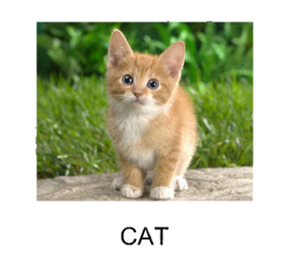
Background
Image Classification
Define:
predicting the class of one item in a picture
Input
a single-object image, such as a photograph, is utilized.
Output
a class label is created (e.g., one or more integers that are mapped to class labels).

Slide 12
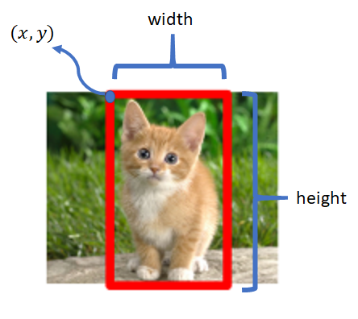
Background
Object Localization
Define:
Determine the presence of items in a photograph and use a bounding box to pinpoint their location.
Input
an image with one or more things, such as a photograph, is utilized.
Output
one or more bounding boxes (e.g., defined by a point, width, and height).

Slide 13
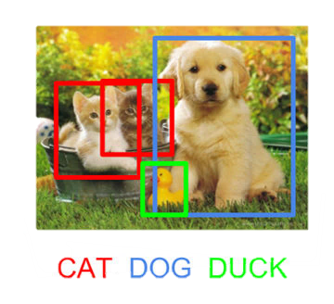
Background
Object Detection
Define:
Using a bounding box, determine the presence of things in an image and the types or classes of the objects discovered
Input
an image with one or more things, such as a photograph, is utilized
Output
One or more bounding boxes (e.g., specified by a point, width, and height)

Slide 14
Background
Object Detection: Types
Real-time
Task of doing object detection in real-time with fast inference while maintaining a base level of accuracy
Offline
The task of doing the detection of objects, mainly depends on the strength of performance

Slide 15
Object Detection Algorithms series
Object Detection
R-CNN
SSD
YOLO
HOG
Fast R-CNN
Faster R-CNN
R-FCN
YOLO1
YOLO2
YOLO3
YOLO4
YOLO5
Offline
Real-time

Slide 16
Literature Review

Slide 17
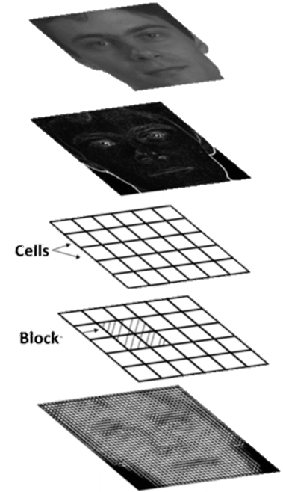
Literature Review
Input Image
Gradient Computation
Oriented Binning
Block Normalization
Hog
Algorithms
Histogram of Oriented Gradients (HOG): 1996
Canny Edge Detector and SIFT are examples of feature descriptors (Scale Invariant and Feature Transform). It is used in computer vision and image processing for object detection. The method counts how many times a gradient orientation appears in a certain region of a picture.

Slide 18
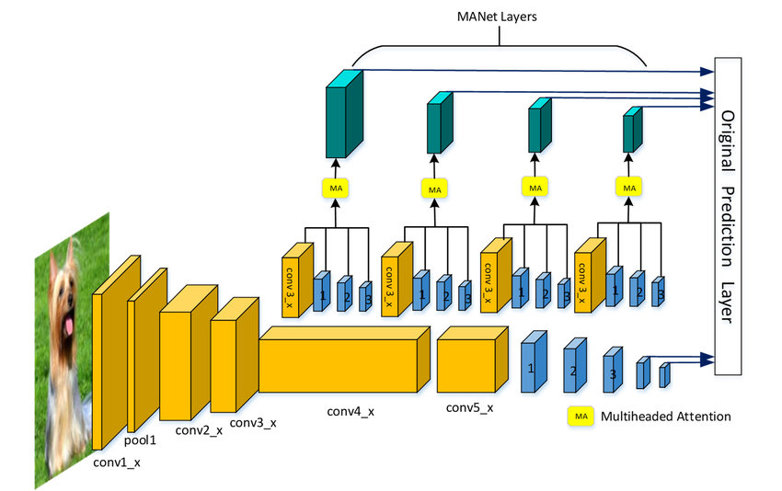
Literature Review
Algorithms
Single Shot Detector (SSD): 2016
Detect several objects inside a picture using a single shot.

Slide 19
Literature Review
Algorithms
Region-based Convolutional Neural Networks (R-CNN): 2014
Combination of region recommendation and Convolutional Neural Networks (CNNs)

Slide 20
Literature Review
Algorithms
Fast R-CNN: 2015
The CNN is fed the input picture, which creates a convolutional feature map. As a starting point, use the convolutional feature map.

Slide 21
Literature Review
Algorithms
Faster R-CNN: 2015
Deep convolutional network for object detection that appears to the user as a single, end-to-end, unified network.

Slide 22
Literature Review
Algorithms
Region-based Fully Convolutional Network (R-FCN): 2016
Reduces the amount of work necessary for each ROI, which speeds up the process.

Slide 23
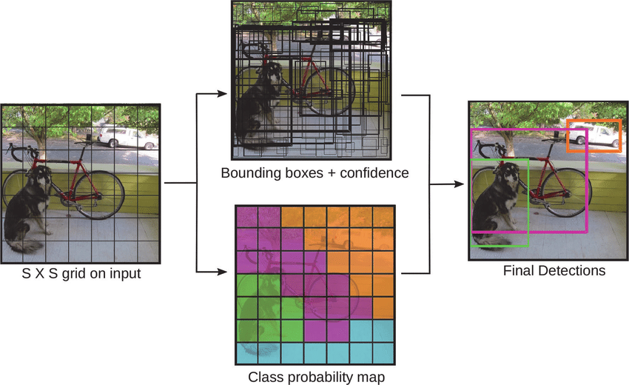
Literature Review
Algorithms
You Just Look Once (YOLO): 2019
A single neural network is used in an object detection method. In contrast to several other object detection algorithms that do a bit-by-bit scan of the picture.

Slide 24
Background
Datasets

Slide 25
Literature Review
Datasets
Dataset | Gun | Rifle | Knife | People | Total
Crime Detection | 2000 | - | 1050 | 100 | 3150
Weapon detection | 10770 | 187 | 7140 | - | 18097
Weapon Classification | 315 | - | 12900 | - | 13215
Handgun Dataset | 1900 | - | - | - | 1900
Knife Dataset | - | - | 500 | - | 500
Total Datasets |  |  |  |  | 36862

Slide 26
Analysis

Slide 27
Analysis
Function Requirement
Login
Create account
Identify the person holding the gun
Identify the person holding the knives
Identify the person holding the Trifle
Create an alarm if the model knows that there is something that triggers an alarm
Display camera stream
Logout

Slide 28
Analysis
Non-Function Requirement
The system security
Visibility all 24⁄7
Accuracy in recognizing object detection
Speed in recognizing object detection
Preserve the privacy of the place

Slide 29
Analysis
Stakeholders
System
Admin
CCTV
Users

Slide 30
Timeline

Slide 31
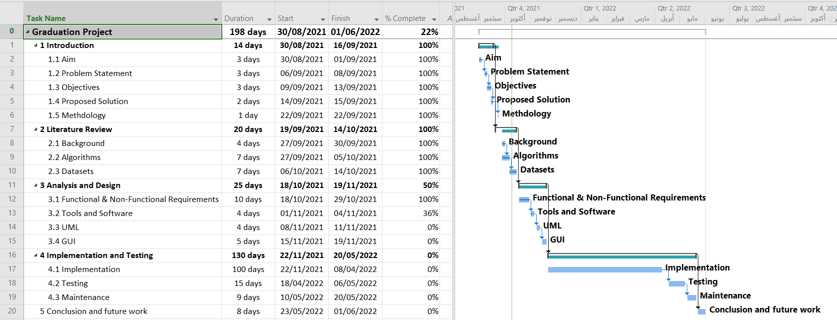

Slide 32
Tools

Slide 33




Tools
Prog. Language
Code Editor
PyCharm IDE
Code Hosting
Microsoft GitHub
Python
SQLite
Database

Slide 34

Thanks! For Listening

